Slide 1
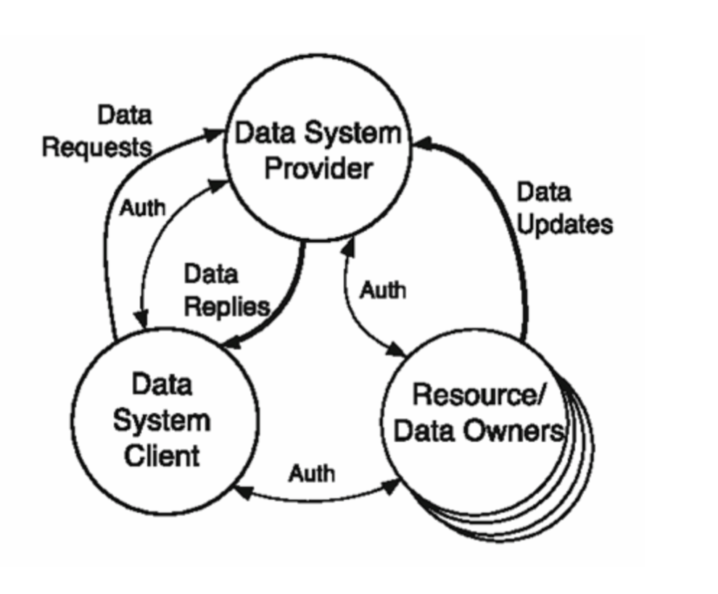
Data 200 review
Data Management

Slide 2
Three Main Sources of Data
Local files: files downloaded or present in the file system.
Relational databases: provides data in the form of relational tables in response to queries .
API Service Providers : “Application Programming Interface, (API)” allows clients to access data over the network.

Slide 3
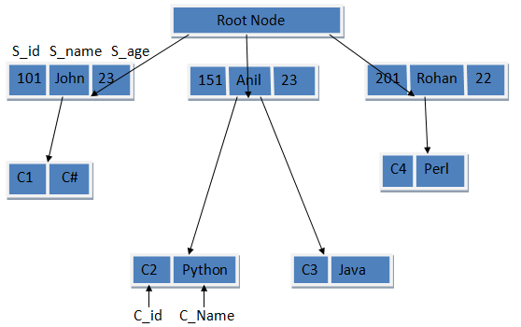
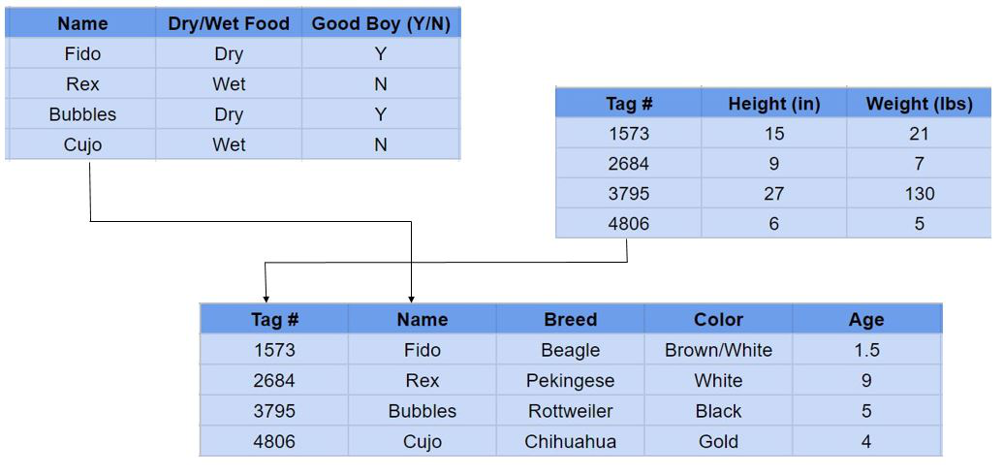
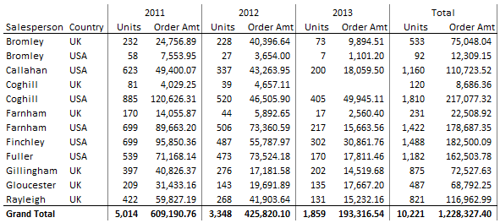
The Three Main Data Models
1. Tabular data model
2. Relational data model
3. Hierarchical data model
Hierarchical data model
Relational data model
Tabular data model

Slide 4
Jupyter notebook + Github
How do you call a snake that’s exactly 3.14 meters long? ☺

Slide 5
Panda
https://pandas.pydata.org/docs/reference/io.html
Numpy
https://numpy.org/doc/stable/reference/routines.statistics.html

Slide 6
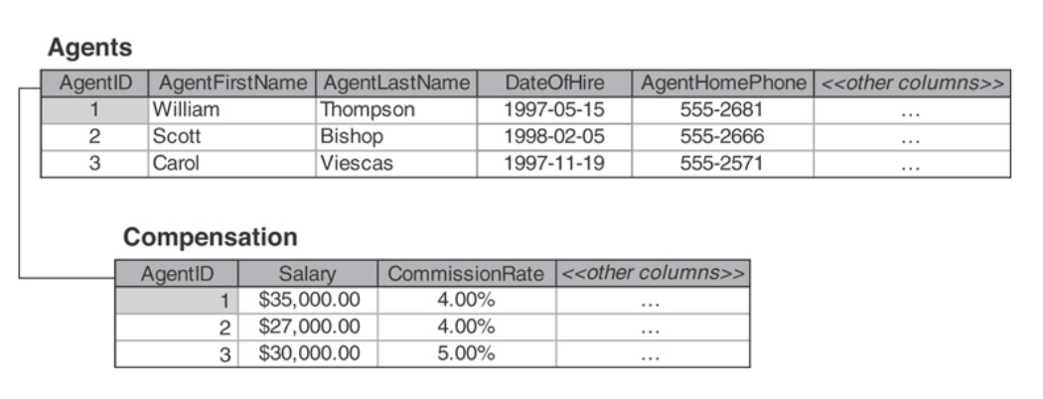
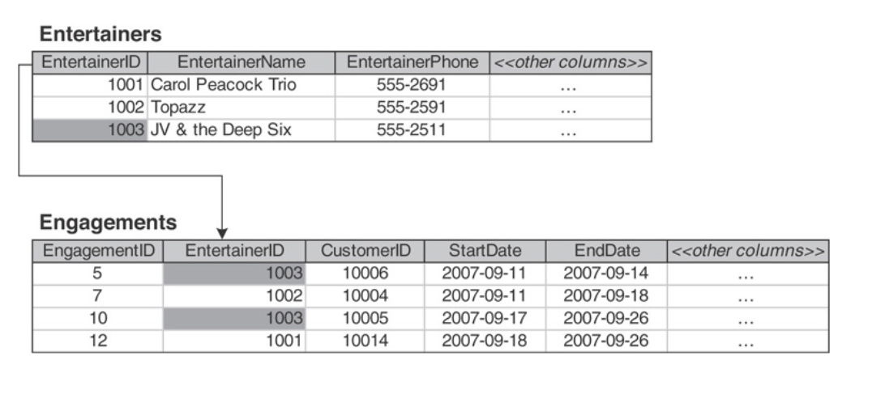
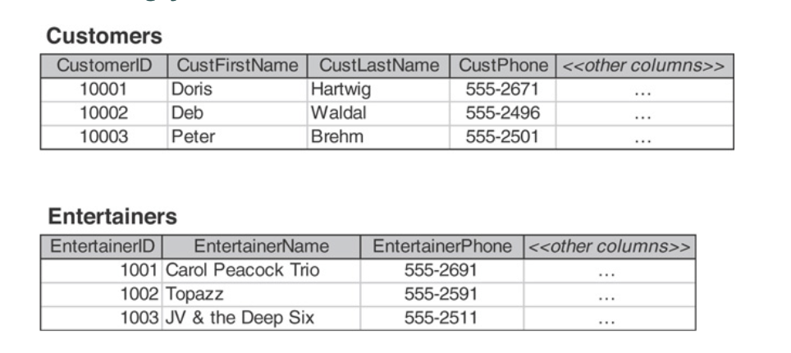
Linking table
Relational Database
One-to-one
One-to-many
Many-to-many

Slide 7
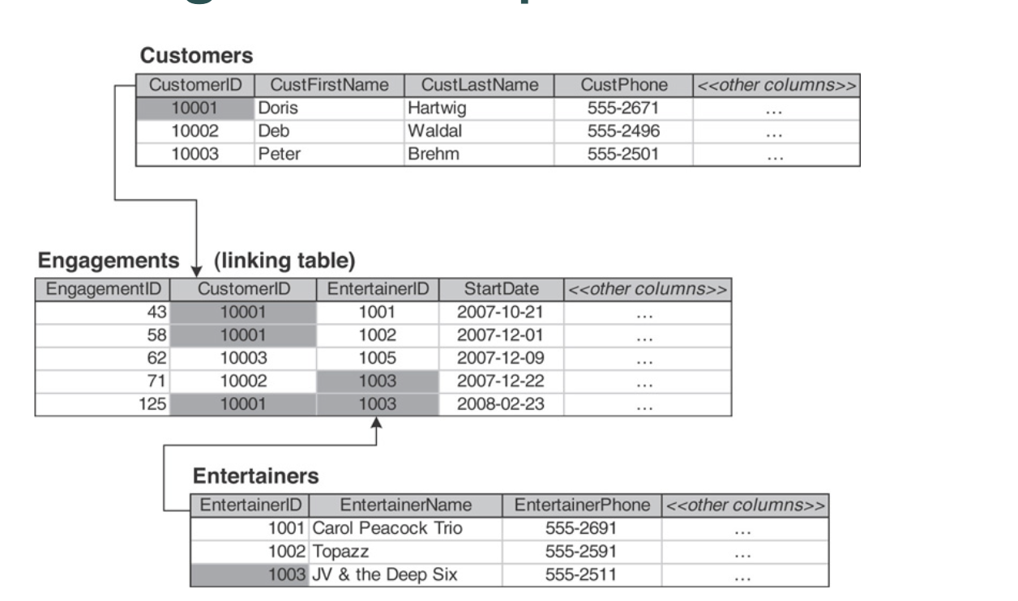
Linking table

Slide 8
Database Management System
A DBMS can:
Create ore remove variables
Take note of integrity rules (constraints)
Take note of authorizations (who is allowed do what, on what)
Update variables (honoring constraints and authorizations)
Provide results of queries
and more…
CART:
Create
Add
Read
Update

Slide 9
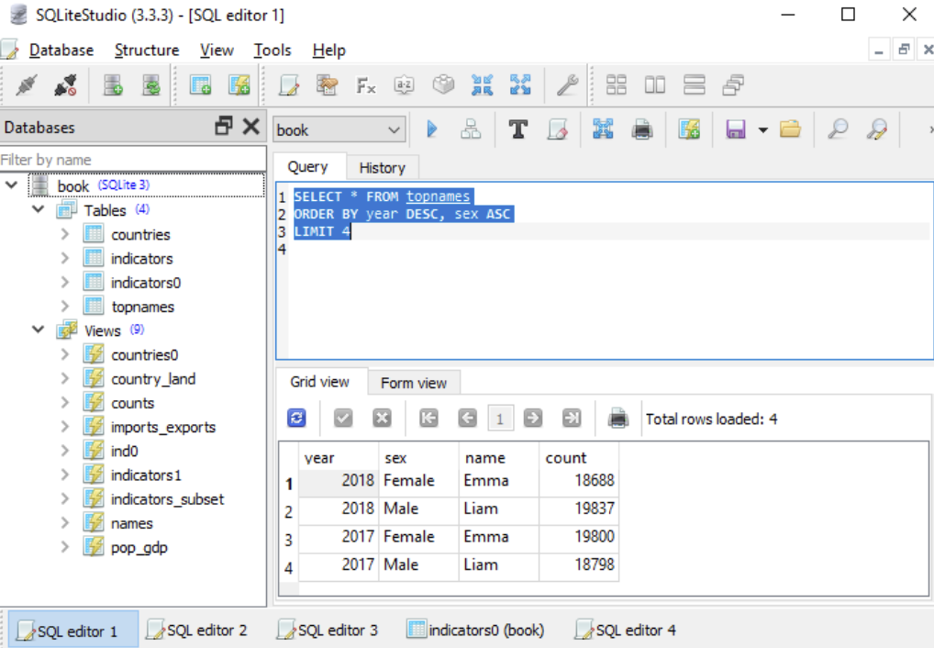
SQL
SQLite
SQLiteStudio

Slide 10
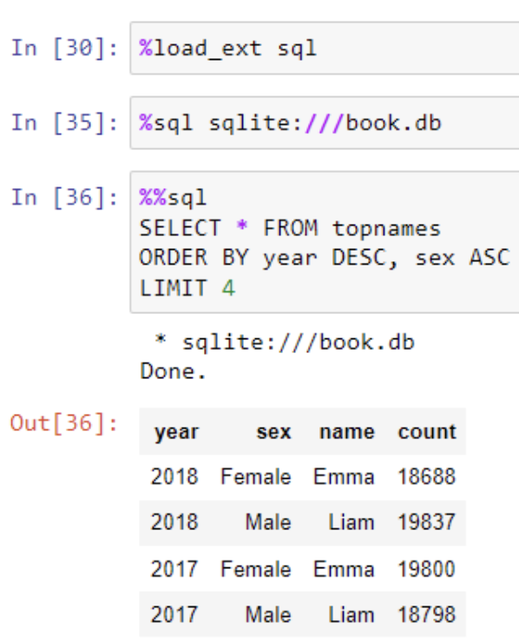
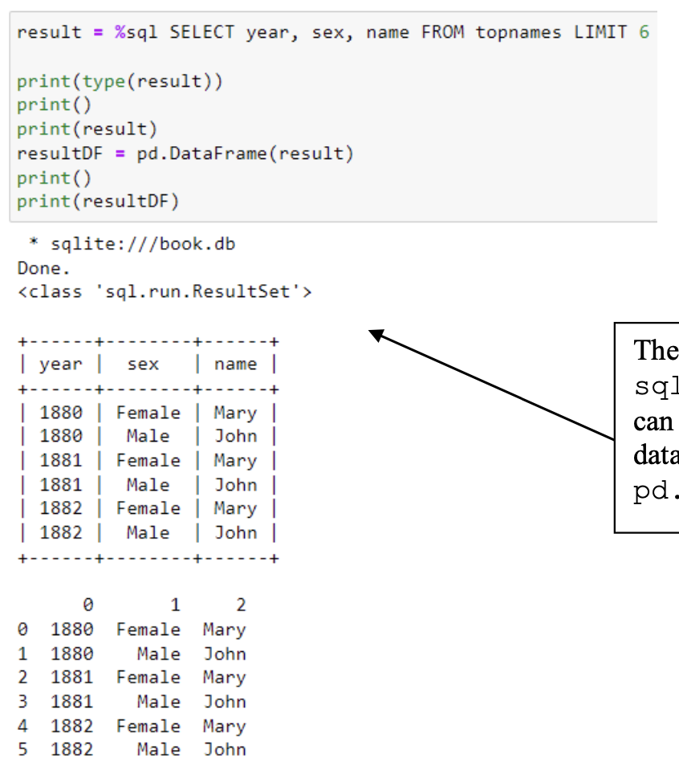
IPython SQL Magic

Slide 11
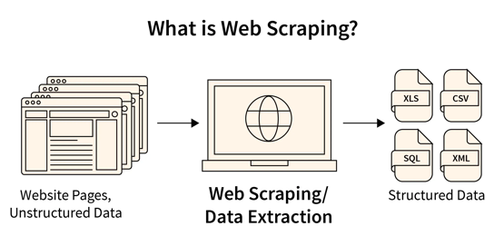
Webscrapping
Identify the URLs
Inspect the Webpage
Identify the Data You Want to Scrape
Write Code for Web Scraping
Code Execution
Store Final Data

Slide 12
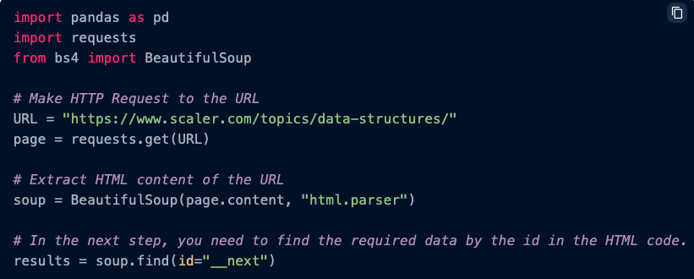

Useful Libraries for Web Scraping
Beautiful Soup
Selenium
https://www.scaler.com/topics/data-science/web-scraping/
https://towardsdatascience.com/how-to-use-selenium-to-web-scrape-with-example-80f9b23a843a
Notes:
https://medium.com/@udofiaetietop/webscrapping-beautifulsoup-or-selenium-3467edb3c0d9#:~:text=Beautiful%20Soup%20is%20effective%20at,online%20interaction%20and%20browser%20automation.

